Slide 1
Hydrogen combustion related research at UTIAS
ORF-RE12-2023
Ömer L. Gülder

Slide 2
Previous hydrogen combustion research at UTIAS
Influence on soot formation when blended with gaseous fuels in laminar diffusion flames (atmospheric and up to 10 bar)
Influence on soot formation when blended with ethylene in swirl-stabilized turbulent non-premixed flames
Flame structure and soot in swirl-stabilized GT model combustor blended with Jet A-1 (up to 50% energy input by hydrogen)

Slide 3
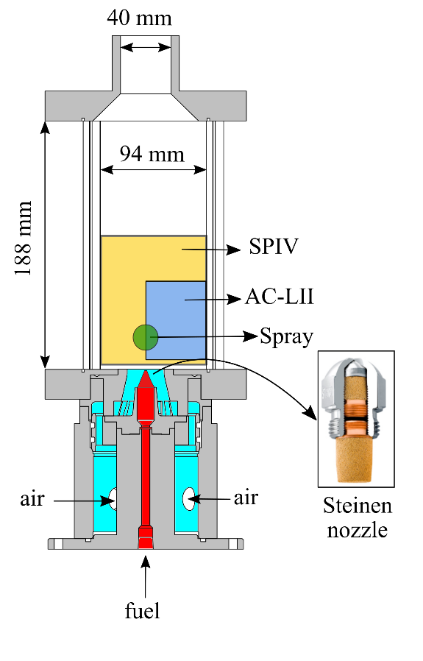
Swirl-stabilized model combustor
Modified Turbomeca helicopter engine combustor – liquid fuel

Slide 4
Jet A-1 in the model combustor (8 kW)

Slide 5
Hydrogen in model GT Combustor (5 kW)
The same geometry as the Jet A-1 case.
Hydrogen supply through a large straight hole through the liquid injector
Identical air flow and swirl

Slide 6
New injector plate concepts to burn either Jet A-1 or hydrogen

Slide 7
Measurements with hydrogen:
Flow field (by sPIV) Heat release map (PLIF OH) Lean blowout limit Combustion efficiency NOx

